Slide 1
Evolution in EVs
Submitted in the partial fulfillment for the award of the degree of
BACHELOR OF ENGINEERING
IN
Development and Operations ( DevOps )
Under the Supervision of:
Dr. Kamaljit Singh Saini
( E3040 )
Department of AIT-CSE
DISCOVER . LEARN . EMPOWER

Slide 2
Submitted by:
Harsh Raj Singh ( 22BDO10006 )
Yash Dwivedi ( 22BDO10019 )
Moksh Gupta ( 22BDO10061 )
Preet Monga ( 22BDO10062 )

Slide 3
Outline
Introduction to Project
Problem Formulation
Objectives of the work
Methodology used
Analysis of features(including any updates planned for the project)
Results and Outputs
Conclusion
Future Scope
References

Slide 4

Introduction to Project
Suppose you are on a trip with your family travelling in your EV.
But what happens when the smooth ride hits a bump? When an EV user encounters a problem, are they stranded on the side of the road?
This research delves into the
challenges and opportunities for
creating exceptional service
experiences for EV users in need.
Car Broke amidst the ride

Slide 5

Introduction to Project
The common problems faced by a
person, driving an EV, are -
Battery power running out before
reaching a charging station
Inconvenient station locations, long
waiting times, and compatibility
issues
Limited repair expertise.
Car Broke amidst the ride

Slide 6

Introduction to Project
To resolve these issues, we are aiming to research on the possible solutions that may enhance the user experience of the EV drivers and make their journeys as smooth as possible.
After resolving the issue

Slide 7
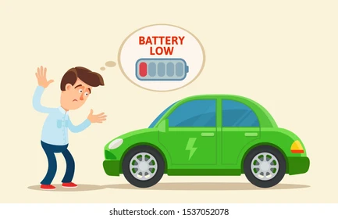

Problem Formulation
If you are travelling in your EV, on your way your EV broke due to many issues such as battery get discharged, any sensor not working properly or battery failed. Due to these alarming reasons people resist to switch to EV.
You are standing alone on a barn road waiting for some assistance.
There comes our idea, where a SOS application will be embedded in your car, to send SOS to nearby charging station. From there a truck will come to your location and helps you.
EV battery low
Mr. Bean waiting for assistance

Slide 8
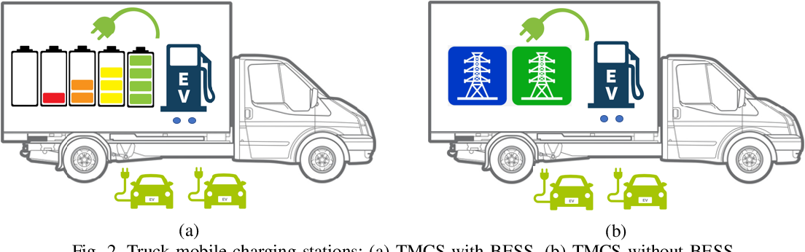
Objectives of the Work
Analysing Current problems in present systems.
Formulating a backup option for EV Users.
Analysing Fabrication Problem of the proposed idea.
(a)Truck mobile charging station with battery energy storage system (b) Truck mobile charging station without energy storage system

Slide 9
Methodology used
Today India produce about 63% of energy needs from non-renewable sources and only 37% of energy needs from renewable source. So we are proposing a idea of using renewable mainly solar to use as power generator and stores these energy in mobile trucks which will provide backup at remote places.
As per the ministry of heavy industry press release of march 2023 there were a total of 6586 Public Charging Stations (PCS) are operational in the country and a total of 2,56,980 EVs are there so mathematically 0.0256 charger on each vehicle so we do propose a extension truck which will divide the power to multiple vehicle just like extension board in our houses.

Slide 10

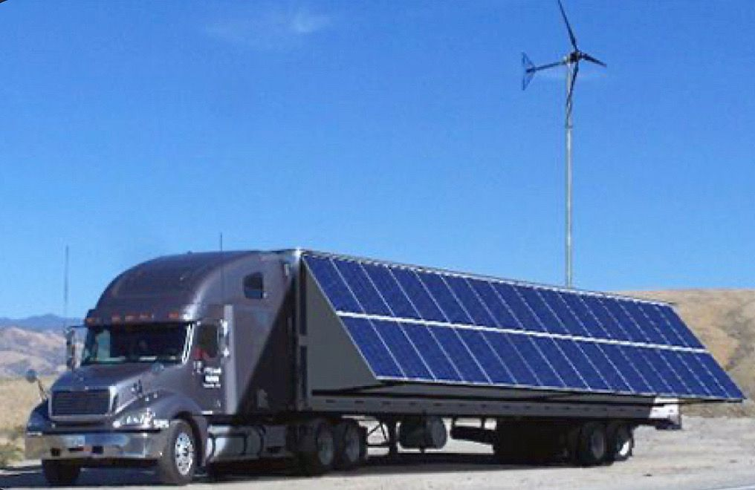
Analysis of features
Backup Truck : Major feature is the backup truck, park your car inside the truck to get it fixed and charged.
Solar Power Dependency : As mentioned in methodology, the truck will be charged by renewable sources such as solar energy, hydro and more.
Truck Carrying Car
Truck Charged via Solar Energy

Slide 11
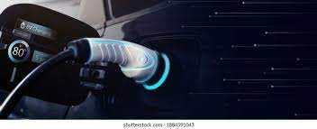
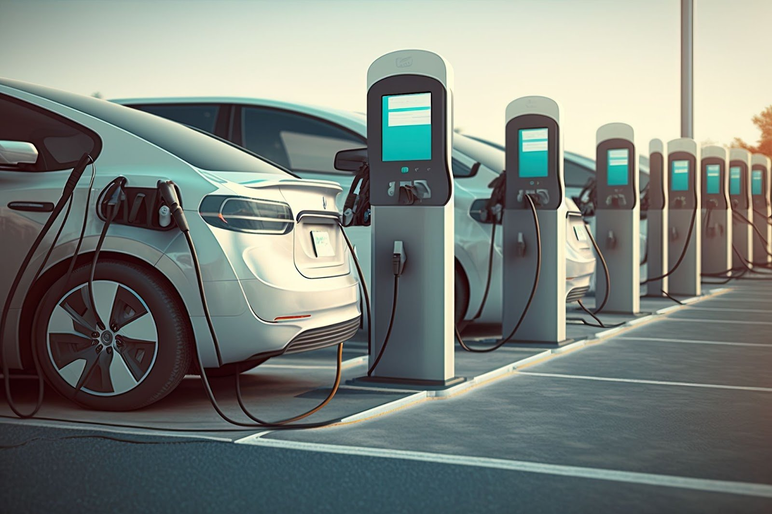
Analysis of features
3. Super Chargers : Truck will be loaded with level 3 fast DC Chargers 50kW to 400kW((480 volts or more) able to rapidly charge battery providing 80 percent battery in 15 - 60 minutes.
4.Business Implementation : Till now, there is no company in India providing this facility. In this project we are going to draft a business strategy to implement this idea practically and efficiently having proper charging stations, trucks, and pricing models..
Super Chargers (Fast DC Chargers)
Charging Station

Slide 12
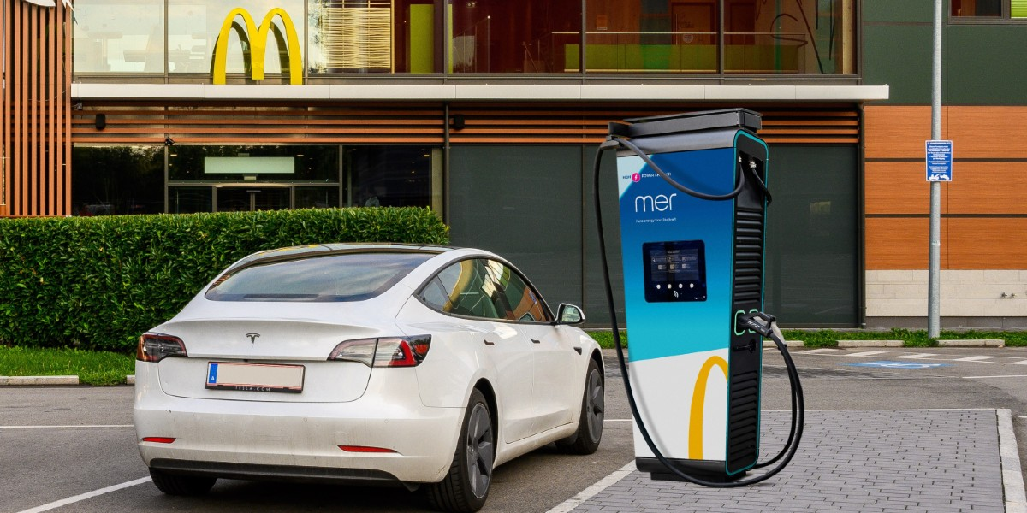
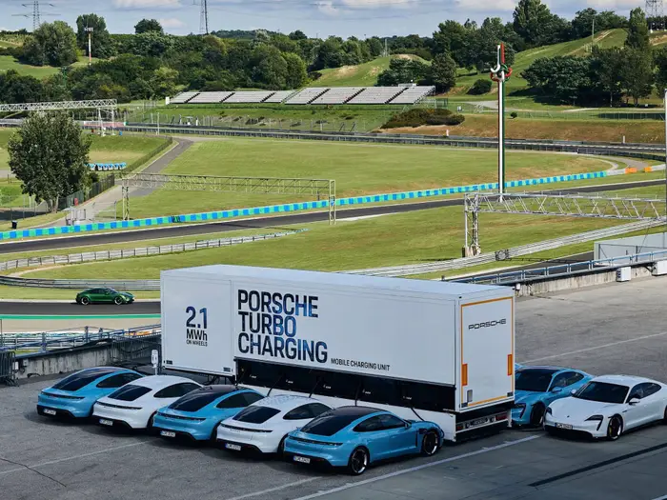
Analysis of features
5. Resting Area: When a person’s car is being charged or fixed, in the meantime there will be resting area facilities like eateries, wifi facility, washrooms and more.
6. Truck as Extension: Like when all the ports on a charging stations are full, in order to avoid long queues, our charging truck will be used as a extension to charge multiple cars at same time.
Charging Station near the McDonalds
Porsche Turbo Charging Truck for multiple cars charging at one time

Slide 13
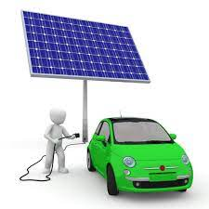
Results and Outputs
Trailers equipped with multiple-charging systems attached to trucks for mobile-charging and lobby services.
Using solar panels ( for renewable source of energy) to generate electricity that charges the EV battery through a charging station.
SOS backup service that will pickup and charge the EV at the same time.
EV being charged by Solar Energy

Slide 14
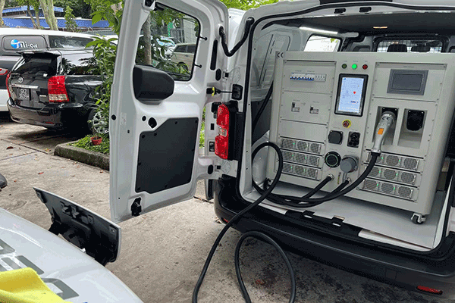
Conclusion
There are some companies like “realac powers" which provide these facilities in USA but there are no such company presently available which will solve this issue. As we know the EVs sector is rising day by day and there is a large need to explore many technical areas and new technology and India with huge 1.4 population need more sustainable options to deliver optimal solutions.
REALAC Powers truck with Charging Equipment

Slide 15
Future Scope
Intelligent Cooling system: These cooling systems would check the temperature in real time and adjust cooling system according to the heating level of the truck.
Battery Replacement : Suppose a person is in a hurry to a place and his battery dies out, now if he waits for a electric truck and then wait for time the battery is fully charged it may result that person may be would not be able to reach on time. So there is a battery replacement system in which a customer can rent a fully charged battery and in meantime his old battery is being charged.
Using Al charging : AI algorithms would help in predicting optimal charge, examine various parts according to the charging need to increases efficiency and range of the electric vehicle.

Slide 16
References
[1]. https://www.semanticscholar.org/reader/4a4b5b768a3f8fc1cc9357f98e7e6d7e151e899b
[2].https://en.wikipedia.org/wiki/Renewable_energy_in_India#:~:text=India%20is%20the%20world's%204th,GW)%20coming%20from%20renewable%20sources.
[3]. https://pib.gov.in/PressReleasePage.aspx?PRID=1910392
[4]. https://pib.gov.in/PressReleaseIframePage.aspx?PRID=1909085
[5].https://blog.evbox.com/level-3-charging#:~:text=Level%203%20charging%20stations%20are%20the%20fastest%20on%20t he%20market,depending%20on%20the%20power%20output.
[6].https://www.evconnect.com/blog/6-places-electric-car-drivers-want-to-see-ev-charging-stations
[7]. https://realacpower.com/ev_charging/
[8]. https://in.pinterest.com/pin/780037597949209943/
[9].https://blog.evbox.com/level-3-charging
[10].https://www.businessinsider.in/thelife/news/porsche-created-a-huge-ev-charging-truck-that-can-recharge-10-porsche-taycans-at-once-x2014xa0see-how-it-works/slidelist/78734098.cms

